Slide 1
Down the Drain
Image Processing Analysis on a Sink Vortex Flow
Brad Rafferty
14 June 2020

Slide 2
Contents
Experimental Setup
Raw Data
Analysis Methods
Results
Summary and Future Work

Slide 3
Experimental Setup
Camera, Lighting, Action

Slide 4
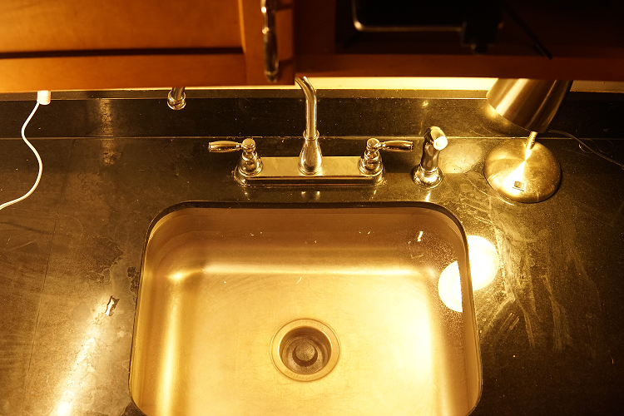
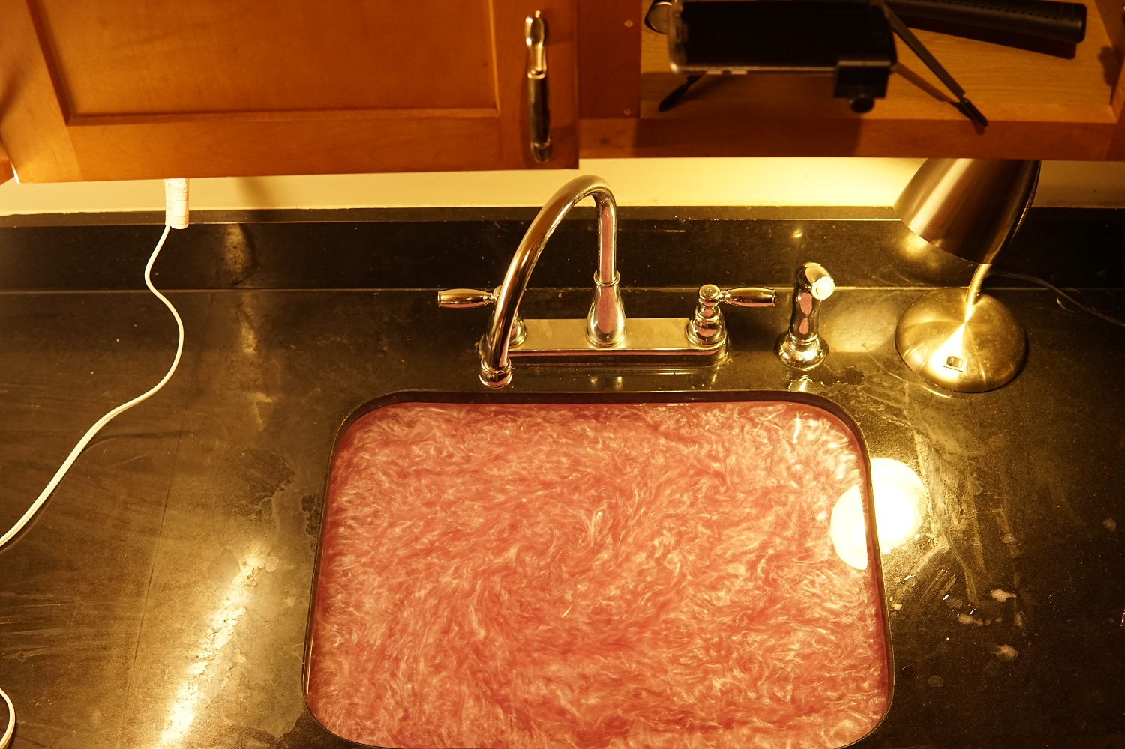
Experimental Setup
Sink drain with garbage disposal
Water seeded with mica powder
Lighting overhead and away from drain center
Record top-down video with cellphone at 30 frames per second
Process:
Prime flow by swirling it
Remove drain plug
Engage garbage disposal for 1-2 seconds
Disengage disposal, allow to drain
Analysis will track properties of the vortex core
Fig 1. Experimental setup, water unseeded
phone
Fig 2. Experimental setup, water seeded with mica powder

Slide 5
Raw Data
Example Raw Videos

Slide 6
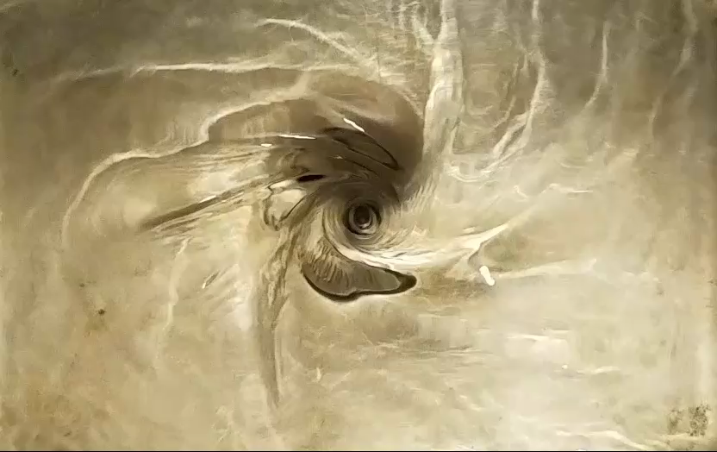
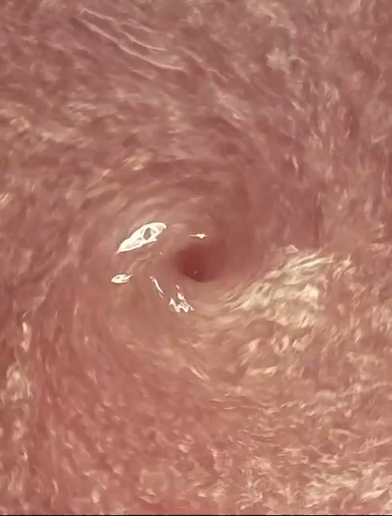
Raw Videos
Originally recorded just clear water
Many features in the flow, however very difficult to detect and quantify repeatably and reliably
Utilized Mica to help isolate the core, allow options for velocity analysis
Darker core contrasts against the lighter surface flow, enabling detection readily
Prevents background noise, e.g. from the sink drain label
Video capture at 30 fps, 1920x1080
Wide field-of-view captured, then cropped in processing
Vid 1. Sink vortex flow, water unseeded
Vid 2. Sink vortex flow, water seeded with mica powder

Slide 7
Analysis Methods
Image Processing & Feature Detection

Slide 8

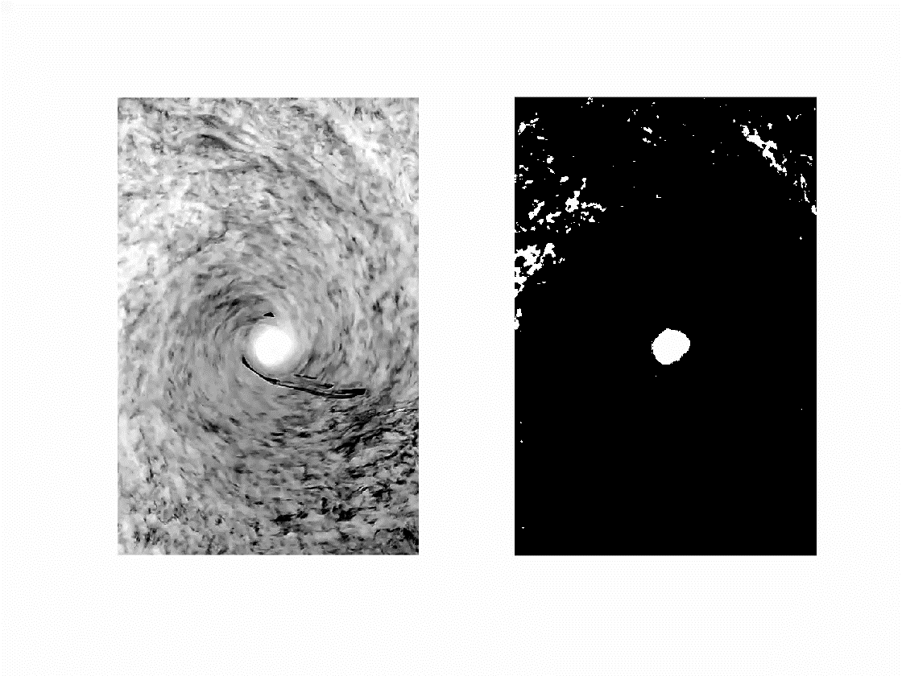
Image Processing
Reference image of sink drain used to determine lengthscale (from diameter) and the center of the frame (center of drain)
Steps:
Trim, crop, and center video
RGB to gray
Enhance contrast
Complement (gray high signal)
Binarize (global threshold, Otsu’s method)
Note: execute image processing on large field of view of the flow, then crop to region of interest within the binarized frames for feature detection
This achieves a higher signal-to-noise ratio with the core most distinguishable compared to image processing on a small region of interest from the start
Vid 3. Raw Video
Vid 4. Grayscale, enhanced, complement
Vid 5. Binarized

Slide 9
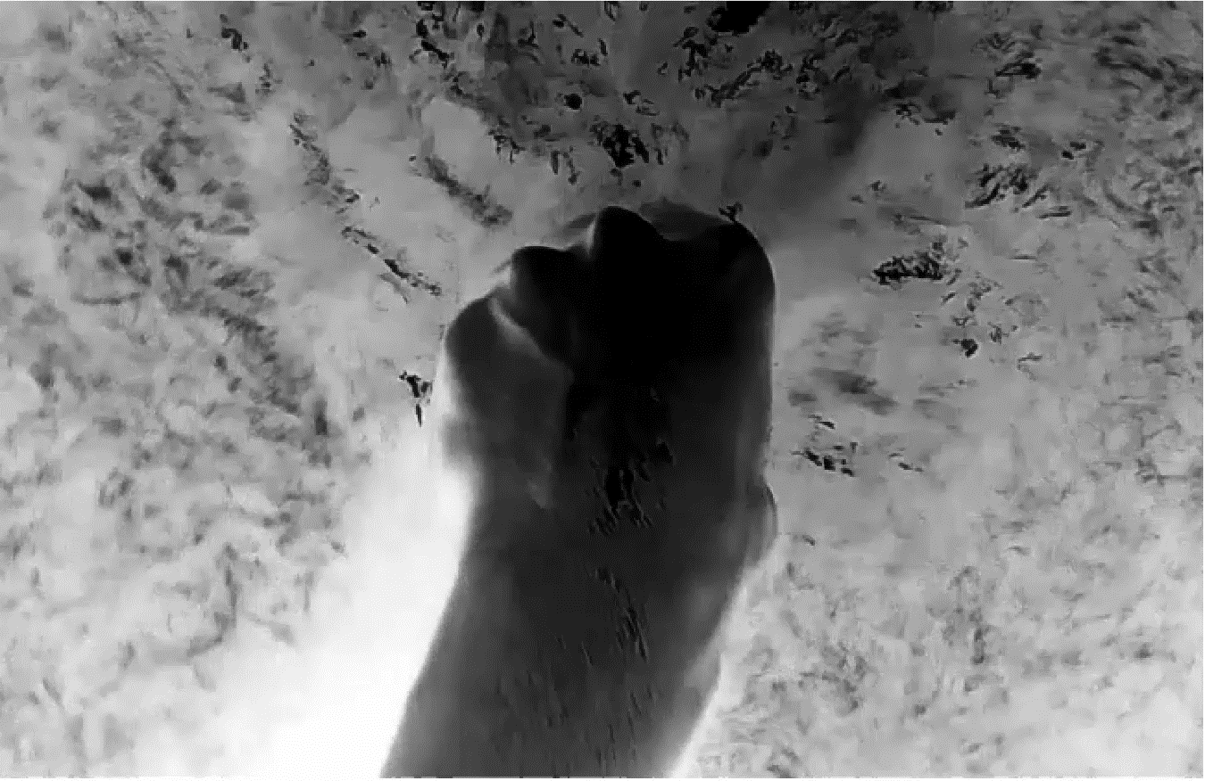
Feature Detection
To isolate the core in binary image:
bwareafilt() to remove all features but the largest one (assumed to be core)
bwconncomp() to retrieve the connected component object
regionprops() to retrieve various data on the conn. Comp:
Centroid, area, perimeter, etc.
Convert from px to cm using scaling factor (drain diameter)
bwboundaries() to extract boundaries of core, for visualization
Calculate distance of core centroid from origin (drain center)
Vid 6. Grayscale video with detected core centroid (red) and perimeter (green) overlaid

Slide 10
Results

Slide 11
Results for One Realization, 1 of 2
The vortex core grows rapidly before reaching a maximum area
The area goes to a local minimum before increasing again as it approaches the drain
Circularity is noisy (due to the rippling edge of the core), and decreases as the core approaches the drain
The distance of the core to the center of the drain decreases, on average, over time
The distance has an interesting sinusoidal nature
Fig 3. Core area over time
Fig 4. Core circularity over time
Fig 5. Core diameter over time
Fig 6. Core distance to sink center

Slide 12
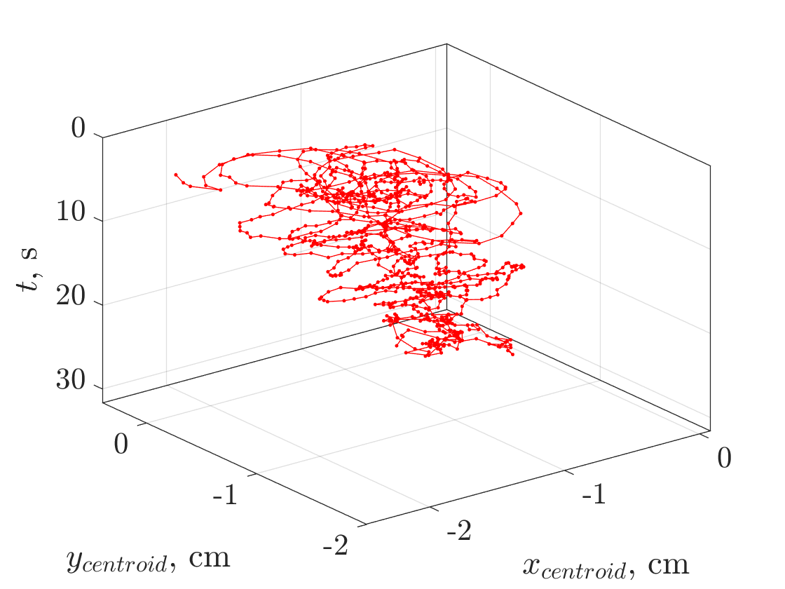
Results for One Realization, 2 of 2
The core centroid is most likely to dwell in a location that corresponds to a negative x and negative y
i.e., the centroid favors to hover over a certain sector of the drain
Fig 7. 2D chaos plot of core centroid location for one realization
Fig 8. 3D chaos plot of core centroid location over time for one realization

Slide 13
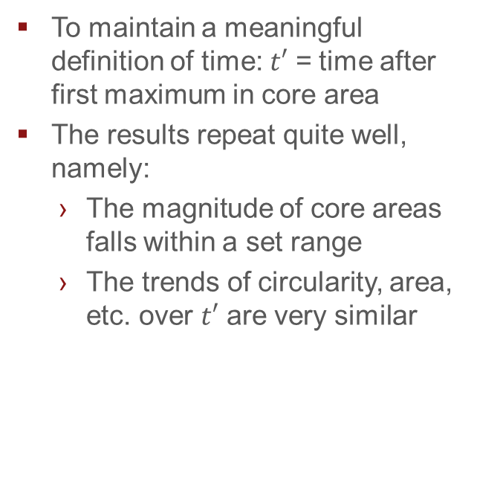
Results for Multiple Realizations, 1 of 2
To maintain a meaningful definition of time: $t′$ = time after first maximum in core area
The results repeat quite well, namely:
The magnitude of core areas falls within a set range
The trends of circularity, area, etc. over $t′$ are very similar
Fig 9. Core area over time
Fig 10. Core circularity over time
Fig 11. Core diameter over time
Fig 12. Core distance to sink center

Slide 14
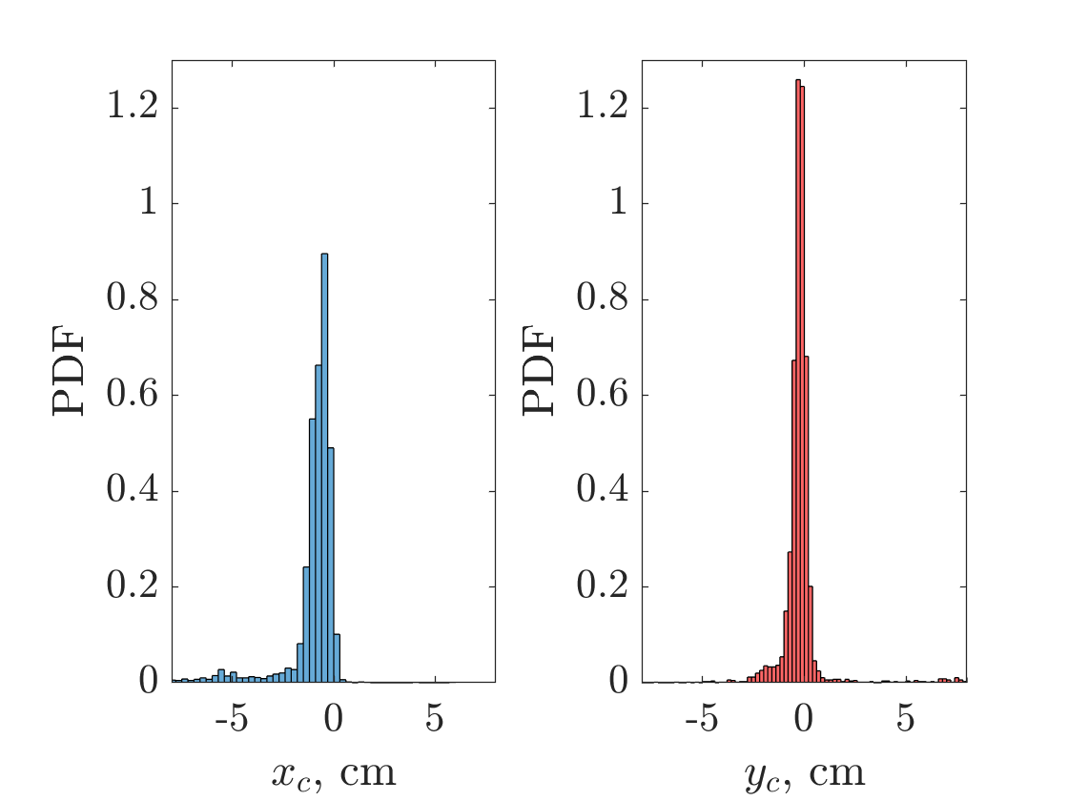
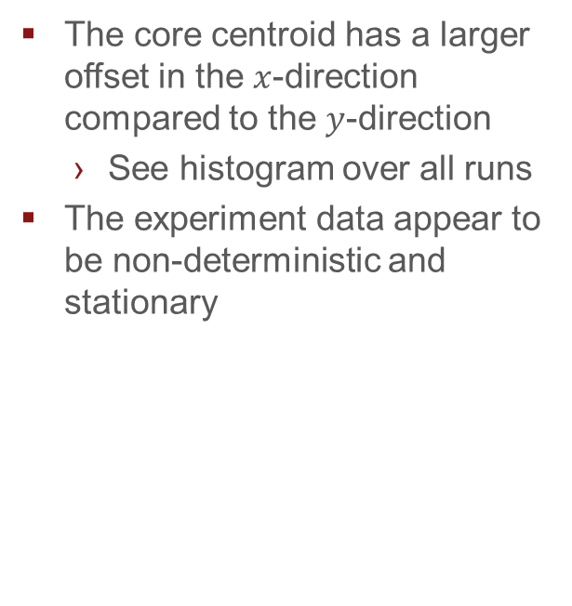
Results for Multiple Realizations, 2 of 2
The core centroid has a larger offset in the $x$-direction compared to the $y$-direction
See histogram over all runs
The experiment data appear to be non-deterministic and stationary
Fig 13. Probability density function of core centroid location with respect to the sink center, in x- and y-dimensions

Slide 15
Summary
Takeaways &
Future work

Slide 16
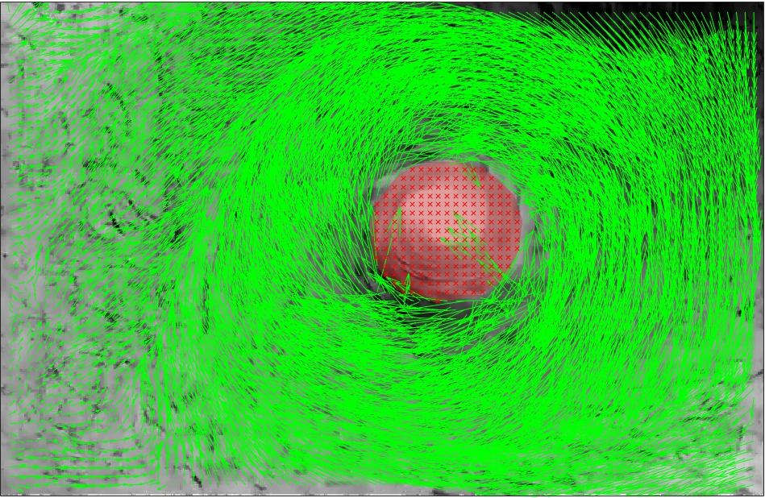
Summary and Future Work
Summary
Sink vortex flow is rich with features and plenty of opportunity for analysis
Order of operations in image processing requires thoughtful consideration
Repeatable experimental setup (lighting, camera location) can dictate data quality
Future Work
Point detectors on unseeded flow
PIV analysis (circulation, compare flow to point vortex + sink flow superposition)
Fig 14. Particle image velocimetry analysis on one image pair of the vortex flow
Fig 15. Velocity vectors derived from PIV on one pair of images

